Slide 1
Diyala University College of Engineering Fourth Year 2012/2013 Computer & Software Engineering Department
Advanced Encryption Standard (AES)
Chapter2: Part4
PRESENTED BY
DR. ALI J. ABBOUD

Slide 2
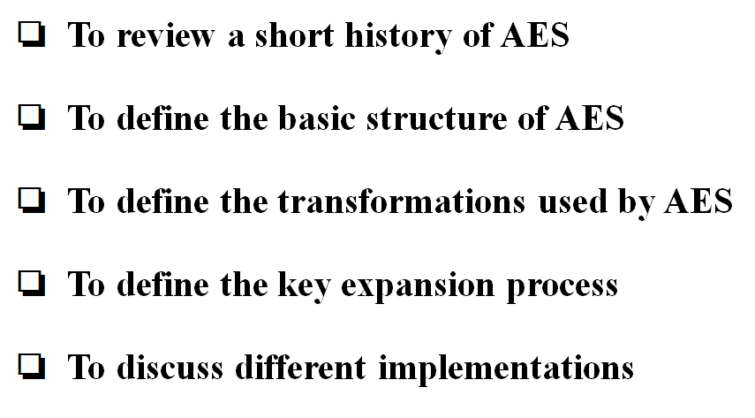
Objectives

Slide 3
2.4.1 Introduction
The Advanced Encryption Standard (AES) is a symmetric-key block cipher published by the National Institute of Standards and Technology (NIST) in December 2001.
In February 2001, NIST announced that a draft of the Federal Information Processing Standard (FIPS) was available for public review and comment. Finally, AES was published as FIPS 197 in the Federal Register in December 2001.
The criteria defined by NIST for selecting AES fall into three areas:
1. Security
2. Cost
3. Implementation.
AES is a non-Feistel cipher that encrypts and decrypts a data block of 128 bits. It uses 10, 12, or 14 rounds. The key size, which can be 128, 192, or 256 bits, depends on the number of rounds.

Slide 4
2.4.1 Introduction
Topics discussed in this section:
1. History 2. Criteria 3. Rounds
4. Data Units
5. Structure of Each Round

Slide 5
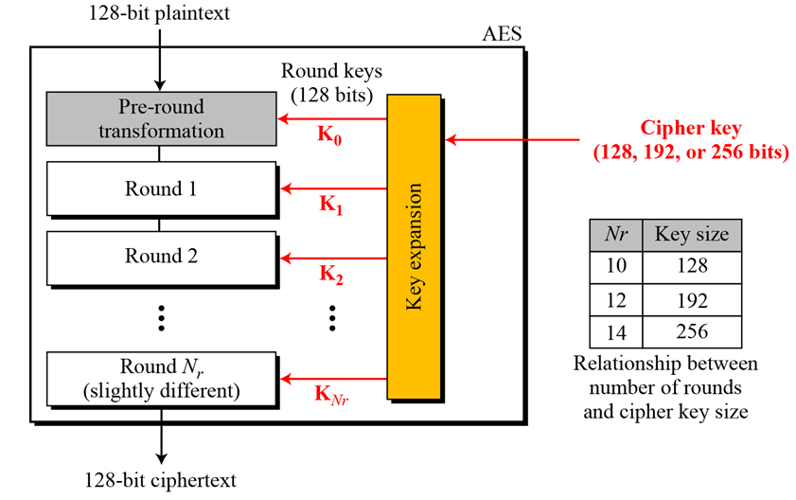
2.4.2 Data Units

Slide 6
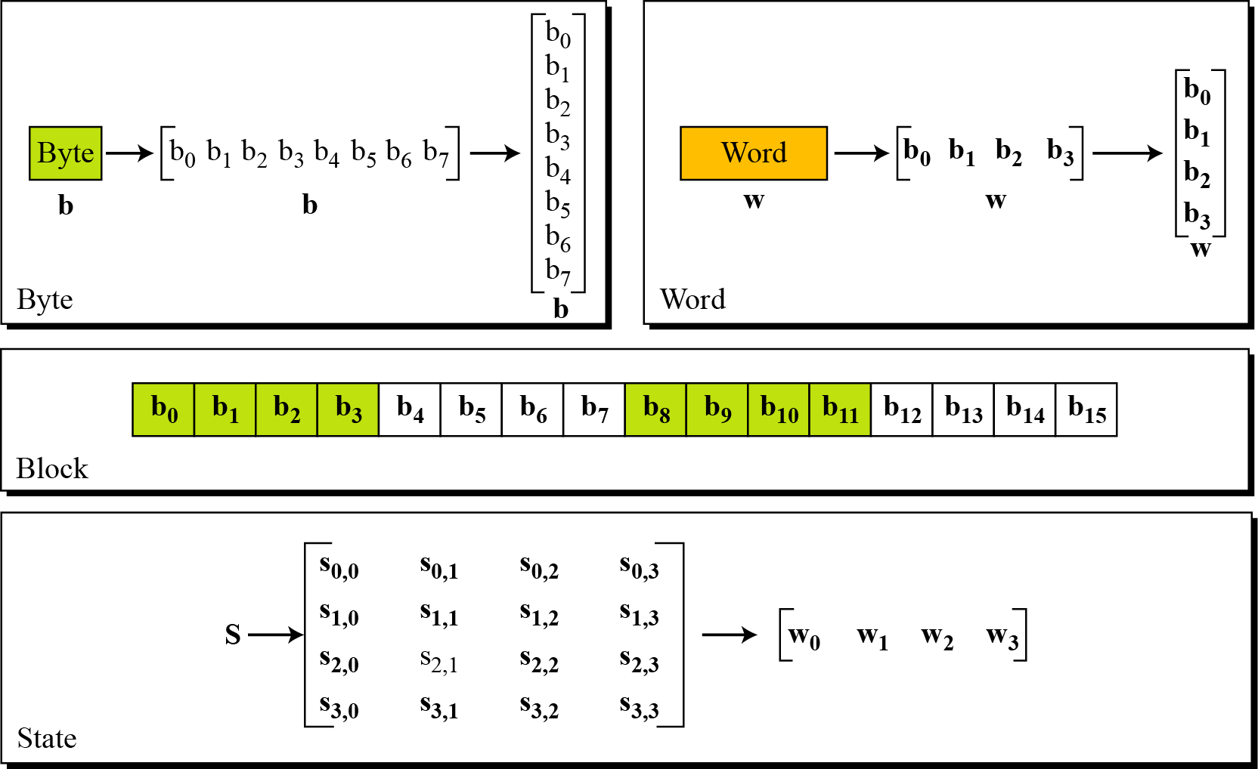
2.4.3 Design of AES Encryption Cipher

Slide 7
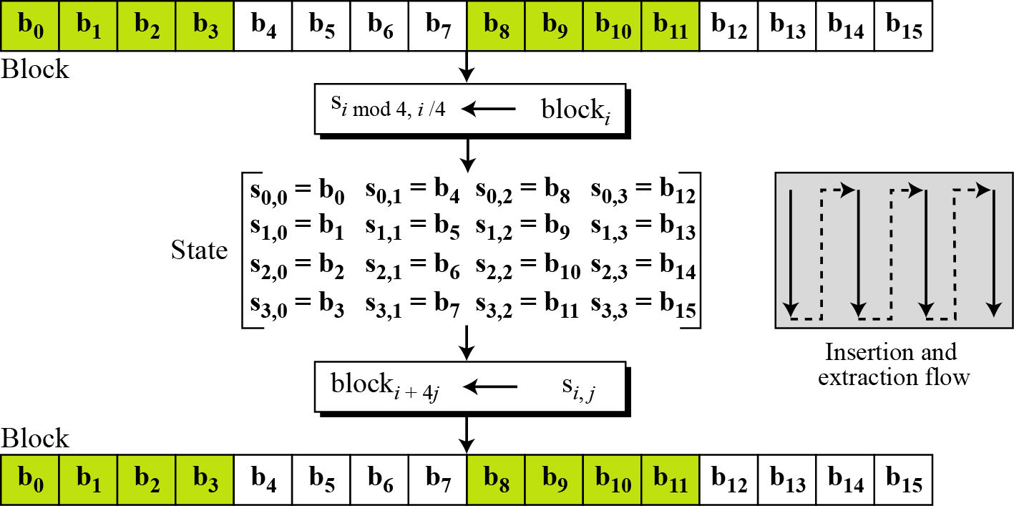
2.4.4 Block-to-State and State-to-Block Transformation

Slide 8
2.4.4 Example: Changing Plaintext to State

Slide 9
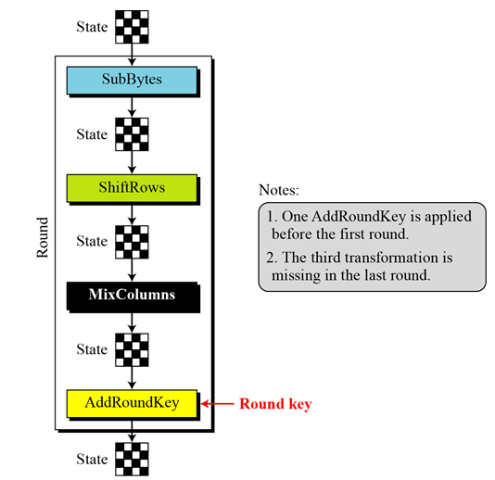
2.4.5 Structure of each round at the encryption site

Slide 10
2.4.6 TRANSFORMATIONS
To provide security, AES uses four types of transformations:
1. Substitution
2. Permutation
3. Mixing
4. Key-Adding
AES, like DES, uses substitution. AES uses two invertible transformations
SubBytes
The first transformation, SubBytes, is used at the encryption site. To substitute a byte, we interpret the byte as two hexadecimal digits.

Slide 11
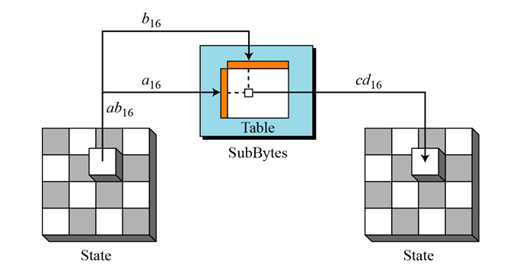
2.4.6.1 Substitution

Slide 12
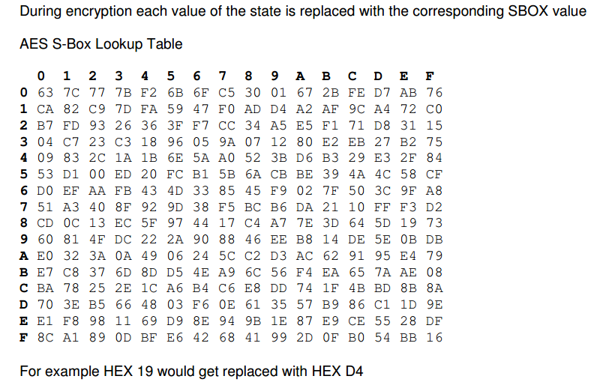
2.4.6.1 AES S-Box Lookup Table

Slide 13
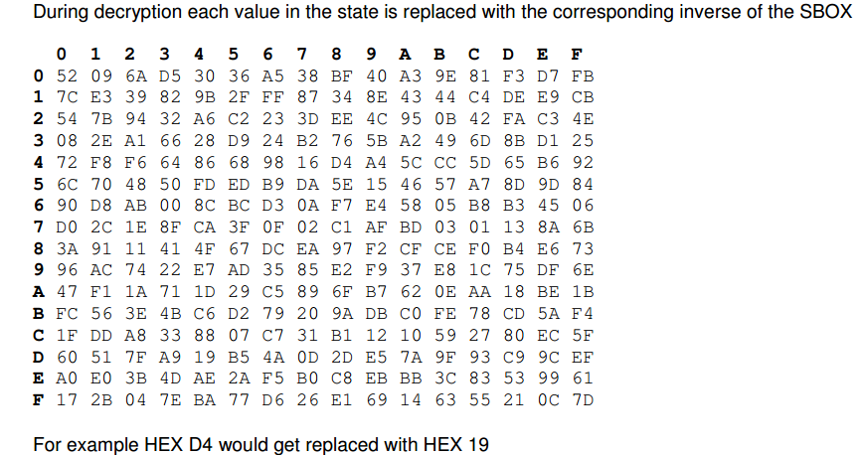
2.4.6.1 AES Inverse S-Box Lookup Table

Slide 14
2.4.6.1 Example: Substitution
Figure below shows how a state is transformed using the SubBytes transformation. The figure also shows that the InvSubBytes transformation creates the original one. Note that if the two bytes have the same values, their transformation is also the same.

Slide 15
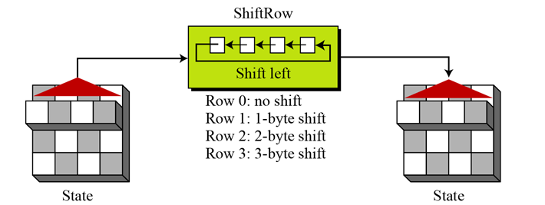
2.4.6.2 Permutation
Another transformation found in a round is shifting, which permutes the bytes.
ShiftRows
In the encryption, the transformation is called ShiftRows.

Slide 16
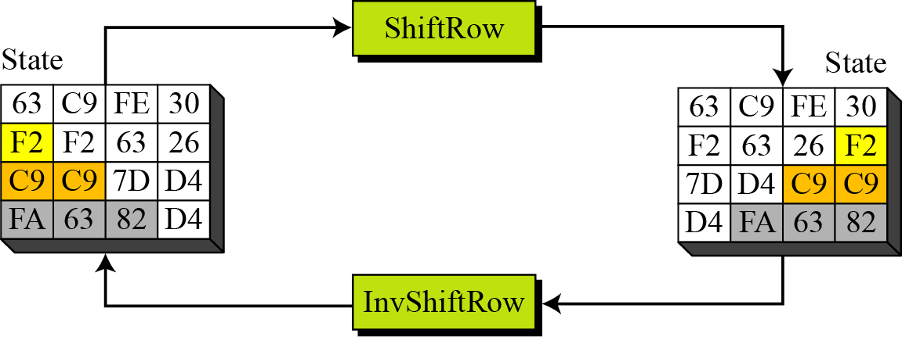
2.4.6.2 Permutation Shift Rows Example1

Slide 17
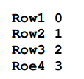
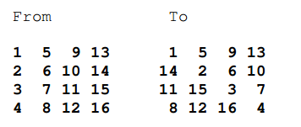
2.4.6.2 Permutation Shift Rows Example2

Slide 18
2.4.6.3 Mixing
We need an interbyte transformation that changes the bits inside a byte, based on the bits inside the neighboring bytes. We need to mix bytes to provide diffusion at the bit level.

Slide 19
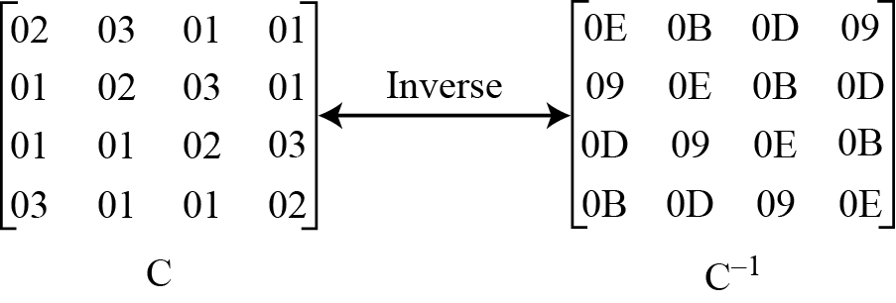
2.4.6.3 Mixing / Constant Matrices
Constant matrices used by MixColumns and InvMixColumns
MixColumns
The MixColumns transformation operates at the column level; it transforms each column of the state to a new column.

Slide 20
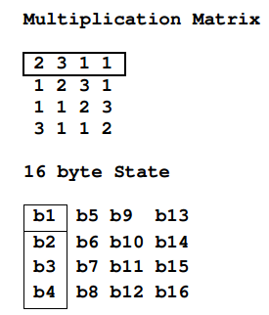
2.4.6.3 Mixing / Example

Slide 21
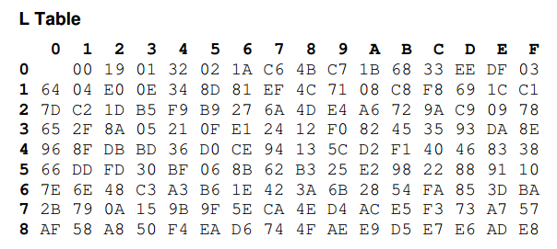
2.4.6.3 Mixing / Galois Field Multiplication
The result of the multiplication is simply the result of a lookup of the L table, followed by the addition of the results, followed by a lookup to the E table. The addition is a regular mathematical addition represented by +, not a bitwise AND.

Slide 22
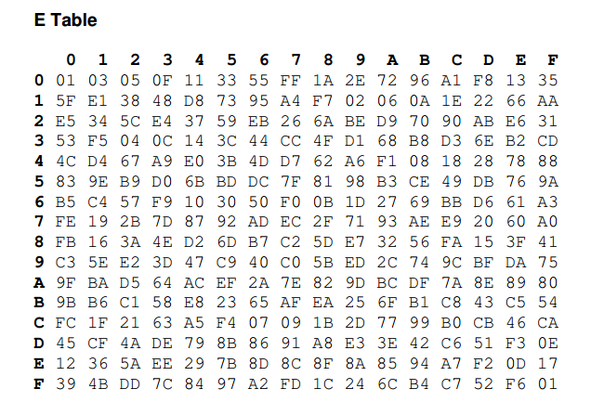
2.4.6.3 Mixing / Galois Field Multiplication
For example if the two Hex values being multiplied are AF * 8 we first lookup L (AF) index which returns B7 and then lookup L (08) which returns 4B.
Once the L table lookup is complete we can then simply add the numbers together. The only trick being that if the addition result is greater then FF we subtract FF from the addition result.
For example AF+B7= 166. Because 166 > FF, we perform: 166-FF which gives us 67.

Slide 23
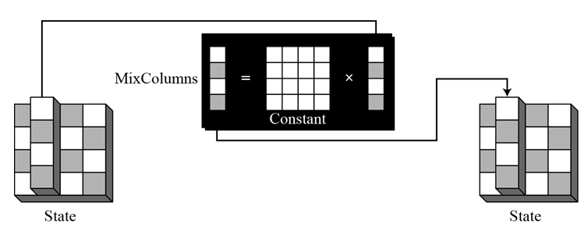
2.4.6.3 Mixing

Slide 24
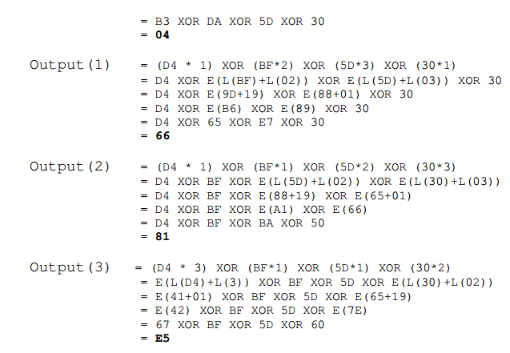
2.4.6.3 Mix Column Example

Slide 25
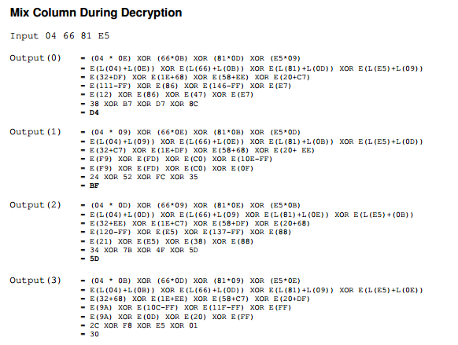
2.4.6.3 Mix Column Example

Slide 26
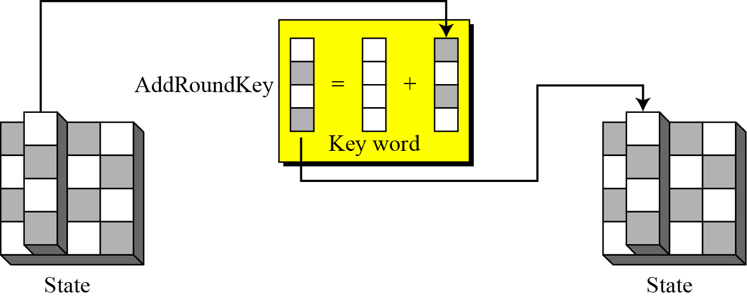
2.4.6.4 Add Round Key
AddRoundKey
AddRoundKey proceeds one column at a time. AddRoundKey adds a round key word with each state column matrix; the operation in AddRoundKey is matrix addition.

Slide 27
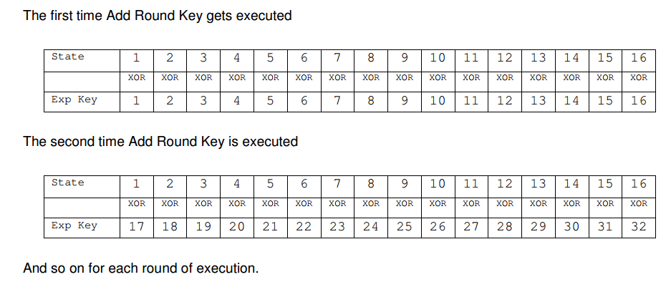
2.4.6.4 Add Round Key
Each of the 16 bytes of the state is XORed against each of the 16 bytes of a portion of the expanded key for the current round. The Expanded Key bytes are never reused. So once the first 16 bytes are XORed against the first 16 bytes of the expanded key then the expanded key bytes 1-16 are never used again. The next time the Add Round Key function is called bytes 17-32 are XORed against the state.

Slide 28
2.4.6.5 Whole AES Example

Slide 29
2.4.6.6 ANALYSIS OF AES

Slide 30
2.4.6.6 ANALYSIS OF AES

Slide 31
End of Chapter2/ Part4

